Slide 1

Welcome To Our Presentation

Slide 2

LIBRARY MANAGEMENT SYSTEM
TEAM MEMBER OF THE PROJECT
Mahdia Tanzeem
ID: G018019
Sanjit Majumdar
ID: G018016
Avijit Bairagi
ID: G018080
Gondhoraj Chandro Sarker
ID: G018092

Slide 3
LIBRARY MANAGEMENT SYSTEM
Submitted To:
Mohamed Raffic Rasul
Java Trainer, LICT

Slide 4

Introduction:
Library Management System is a software used to manages the catalog of a library.
Library is regarded as the brain of any institute; many institutes understand the importance of the library to the growth of the institute and their esteem users (students).

Slide 5
OBJECTIVES :
To provide all the information about the books which are available in library.
To provide facility to search books on the basis some definite criteria.
After the deadline the late fee will be calculated automatically.

Slide 6
ABOUT THE PROJECT:
A Library Management System is an information system.
It is a record keeping application.
It allows authorized access to administrative staff (such as librarian and administrator) to maintain the details of book’s record for book holders.
It provides access to AUTHORIZED members of the library such as administrator and the librarian.

Slide 7
Module: (Admin)
-adminLogin
-borrowBook
-returnBook
-lateFeeCalculation
-sendNotification(email)
-addBookInfo
-updateBookInfo
-searchBook

Slide 8
Module: (Student)
-studentLogin
-studentRegistration
-searchBook
-viewBorrowedBook
-popUpNotificaton

Slide 9
Proposed Working System :
1.Technology and tools
-Java
-Servlet
-JSP
-Swing
-JDBC

Slide 10
Proposed Working System :
2.Sowtware Needed
-Eclipse
-Apache Tomcat
-Oracle 10g XE
-jdk 1.6(min)

Slide 11
Proposed Working System :
3.Hardware Needed
-Server:
Processor: Intel(R) Core(TM) i5-3210M CPU
@2.50GHz (4 CPUs), ~2.5GHz
Memory: 4096MB RAM
OS: Windows 10 Pro 64-bit
-Client:
Processor: Intel(R) Core(TM) i5-3210M CPU @ 2.50GHz (4 CPUs), ~2.5GHz
Memory: 4096MB RAM
OS: Windows 10 Pro 64-bit

Slide 12
Proposed Working System :
3.Platform
-Desktop and Web

Slide 13
Platform
1.Windows
-For Admin
-Swing+JDBC
2.Web
-Student
-JSP+JDBC

Slide 14
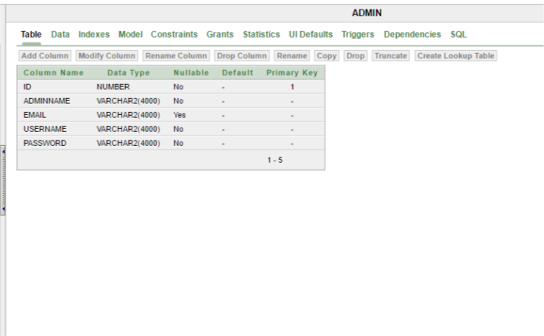
Database Design:

Slide 15
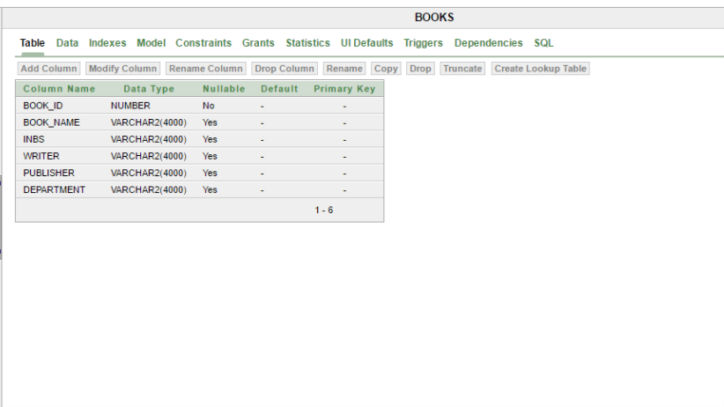
Database Design:

Slide 16
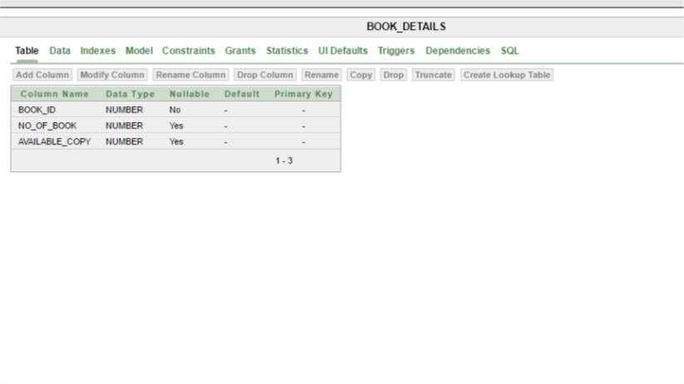
Database Design:

Slide 17
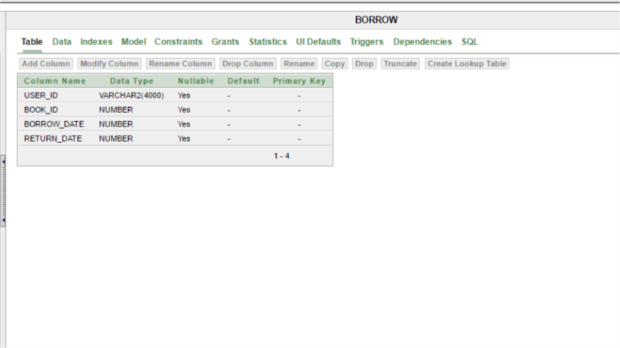
Database Design:

Slide 18
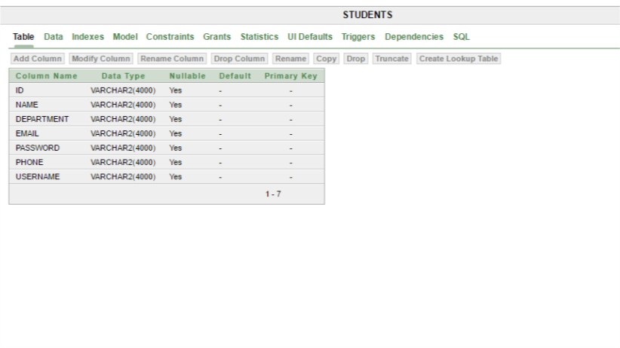
Database Design:

Slide 19
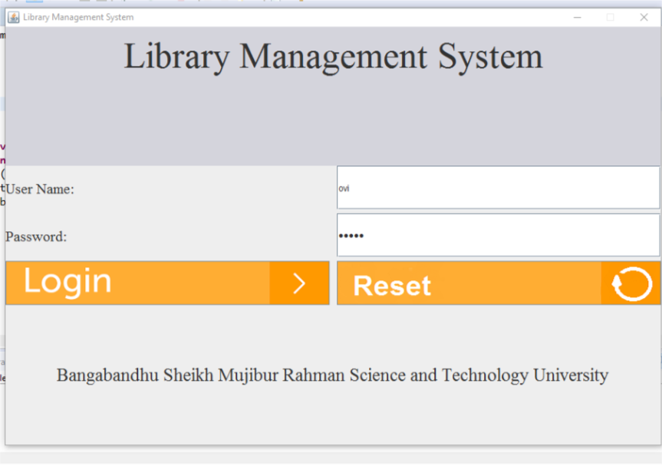
Implementation:

Slide 20
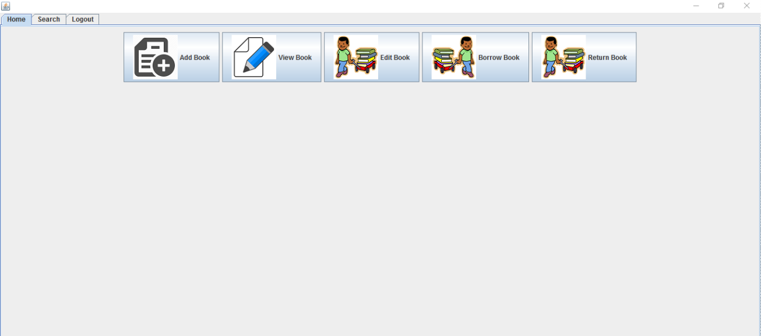
Implementation:

Slide 21
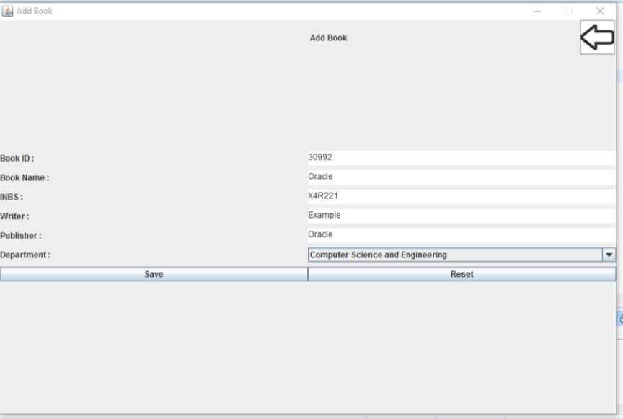
Implementation:

Slide 22
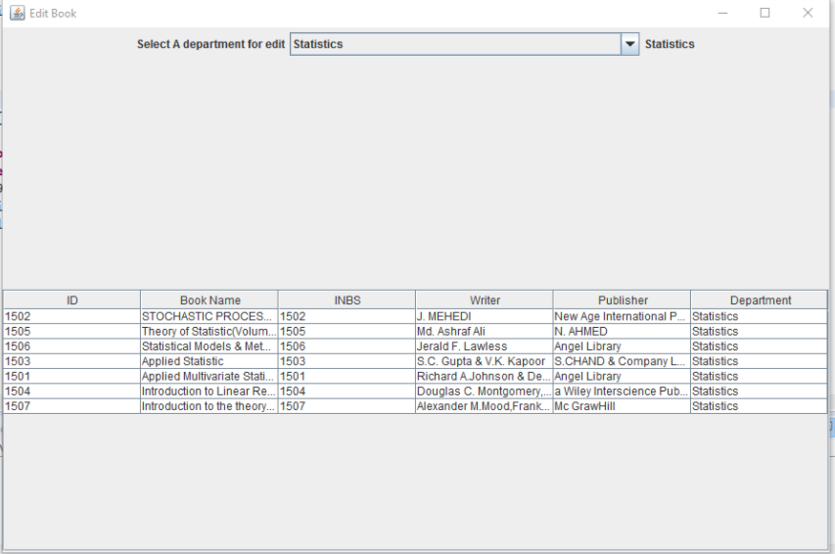
Implementation:

Slide 23
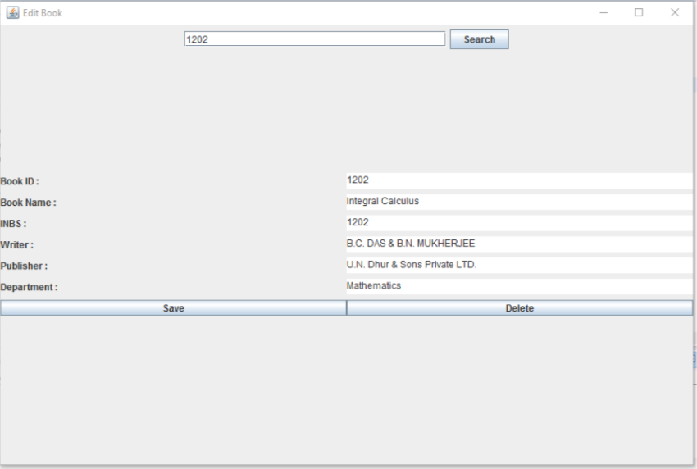
Implementation:

Slide 24
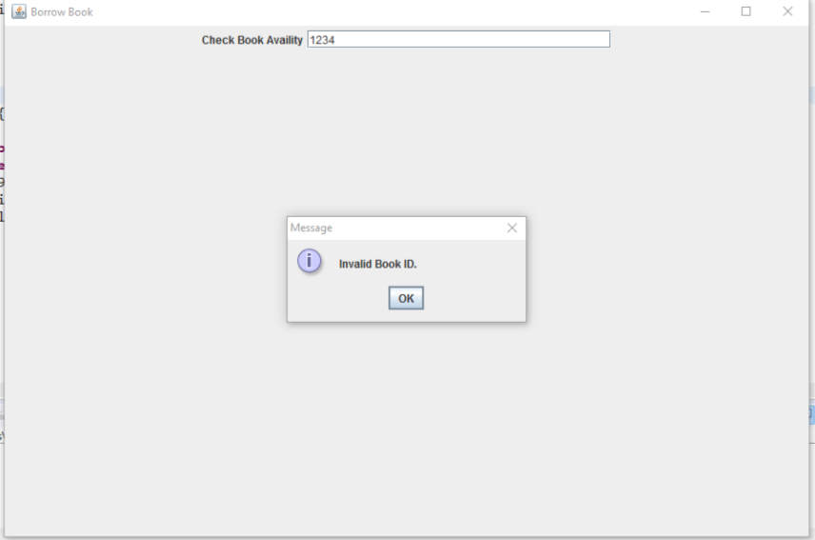
Implementation:

Slide 25
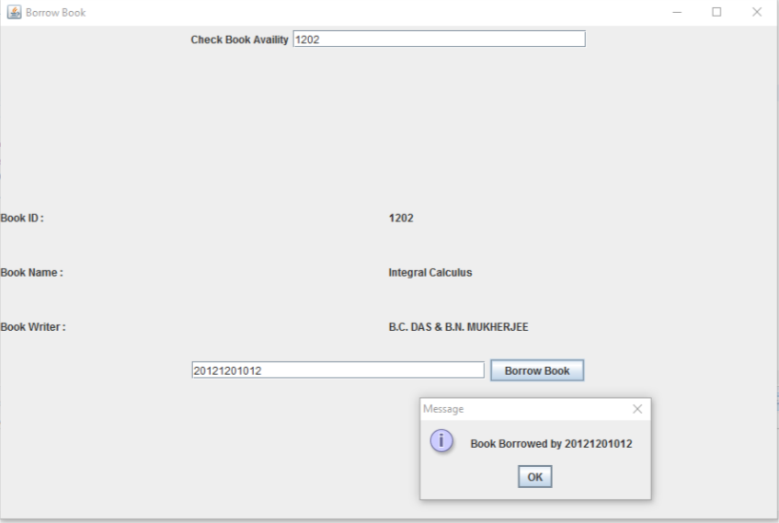
Implementation:

Slide 26
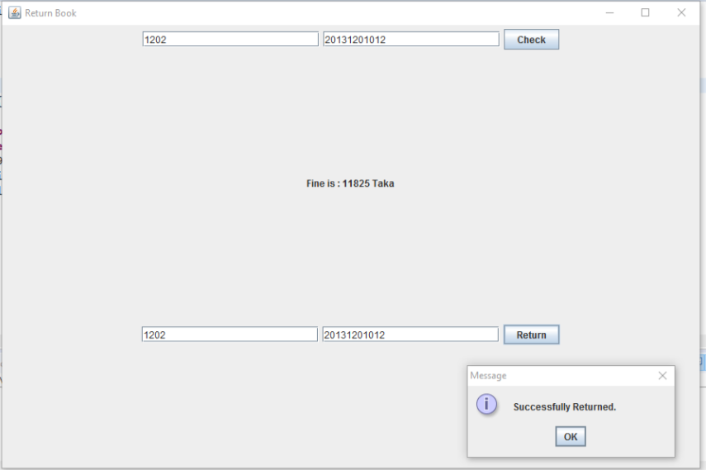
Implementation:

Slide 27
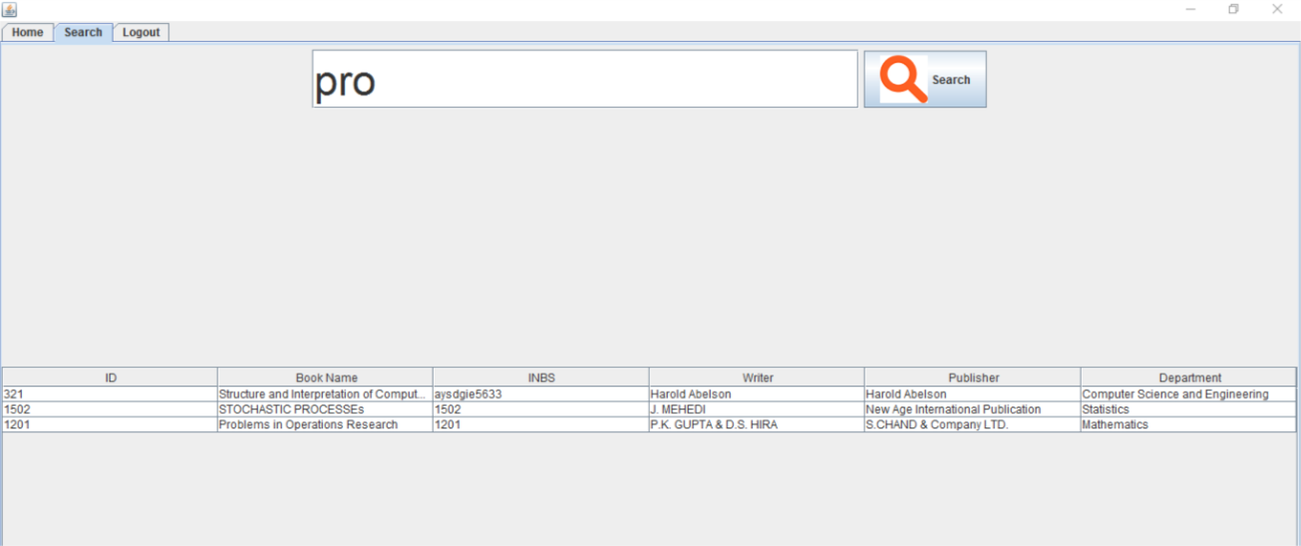
Implementation:

Slide 28
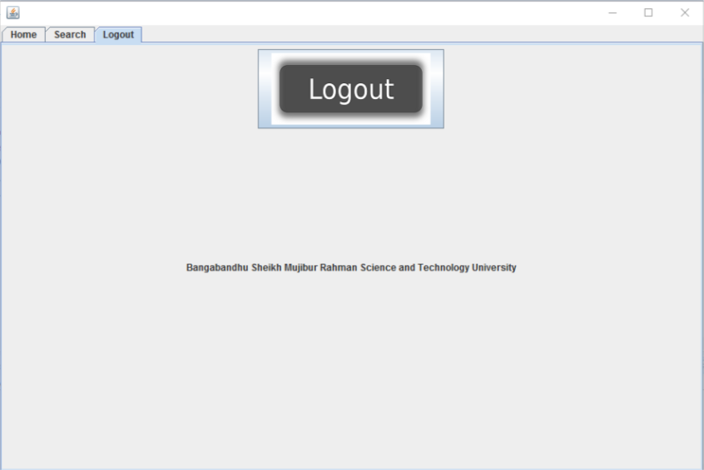
Implementation:

Slide 29
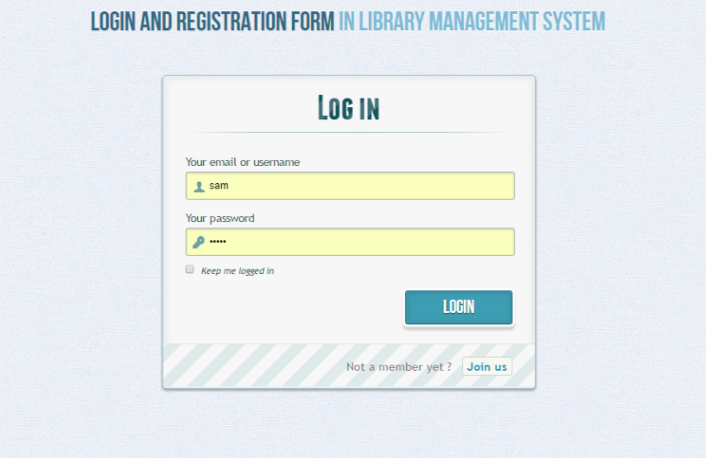
Implementation:

Slide 30
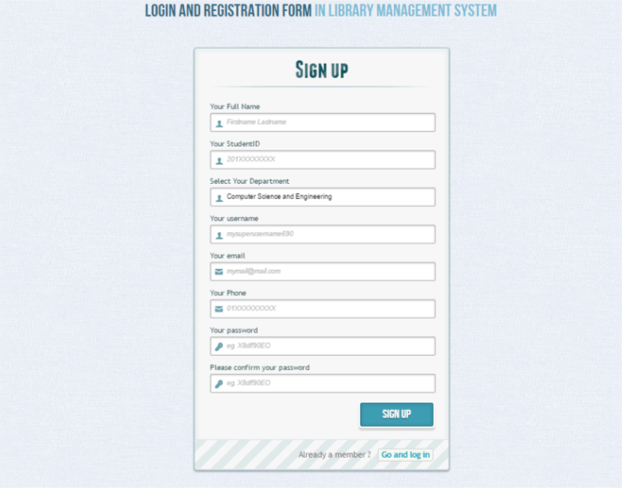
Implementation:

Slide 31
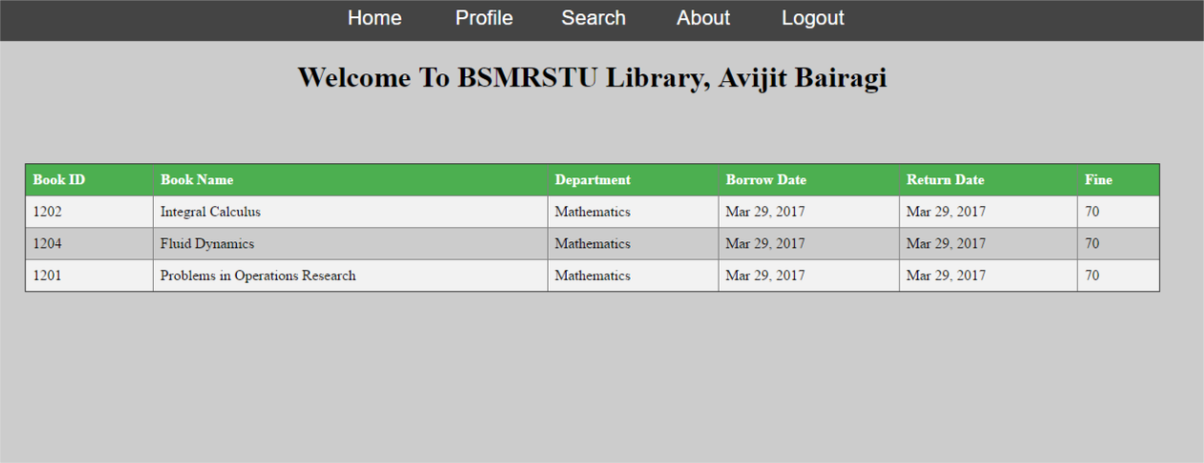
Implementation:

Slide 32
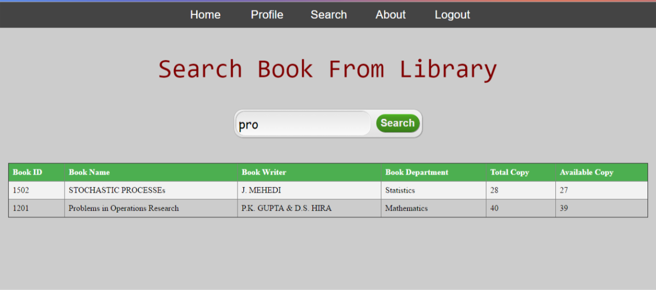
Implementation:

Slide 33
Limitations:
"BAR CODE" Scanning has not been added to this Software.
Notification System. Student will get Email notification to return the book if late.
In the web page the students can not.
JDBC API instead of Hibernate.

Slide 34
FUTURE EXPECTATION :
"BAR CODE" scanning the book info.
Email Notification.
Admin student interaction through Server.
Notification In web page of user.
More advance UI.
Modify the software using Hibernate

Slide 35
Conclusion:
Clearly this system has got to serve the purpose of maintaining the records of all user and server request and response respectively in more efficient and effective way one could imagine.

Slide 36
Thanks Everyone for giving us your valuable time.

Slide 37
Thank You..

